Slide 1
CS 2001 Python programming

Slide 2
Lecture Objectives
Explore more about modules in python

Slide 3
EXERCISE
Create a module with name my_module to incorporate the following functions.
To find the sum of all numbers in a list, set or tuple
To find the maximum of all numbers in a list, set or tuple
To find the minimum numbers in a list, set or tuple
(If the module is run as standalone script, display “ my_module is now available” )

Slide 4
NAMESPACES
A dictionary of identifiers with key as the name of the identifier and value as the data assigned to that identifier
There can be global or local namespaces.
Namespaces can be displayed onto the screen using the functions globals() and locals().
For the main part of the code, local and global namespace has the same meaning.
Within a function local and global namespaces will have different meaning.

Slide 5
Global and local
All the identifiers used within a function are local to that function.
The scope of these variables are confined to that function only.
All the identifiers used in the main code are global
Within a python file if a global identifier and local identifier are given with the same variable name, within the function, the local value will be taken.
If the global value is to be taken, the variable name should be prefixed with keyword ‘global’

Slide 6
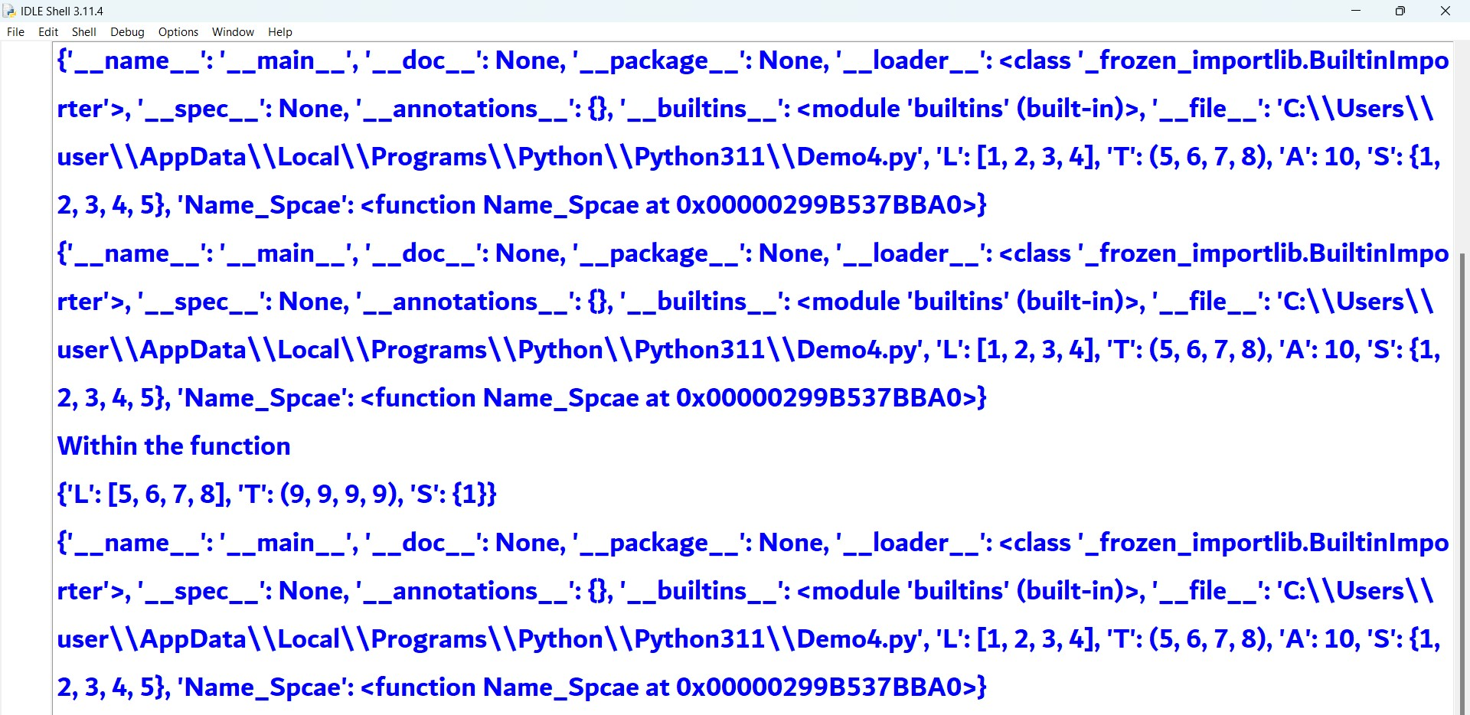
EXAMPLE

Slide 7
SOME IMPORTANT MODULES INPYTHON
random module
‘datetime’ module
‘time’ module

Slide 8
RANDOM MODULE
Mainly applied in the analysis of random process
Various methods are available
random()
randint()
randrange()
choice()
shuffle()

Slide 9
Random()
random()
Function without any arguments
Returns a float value between 0 and 1
Example
import random
random.random()

Slide 10
Randint()
randint(a, b) – to generate a random integer variable
Return random integer in range [a, b], including both end points.
Eaxmple
import random
a=random.randint(1,10)
print(a)

Slide 11
Randrange()
To generate a random number by considering three arguments
Start, stop and step
In randint() by default the step is always 1.
randrange() eliminates this drawback
Example
P=randrange(1,100,10)
print(P)

Slide 12
choice
To randomly choose a variable from a given array of variables ( string, list or tuple)
Example
from random import *
A=choice([11,3,4,7,9])
B=choice((1.3,3.4,5.6,7.8))
C=choice(“Ignited Minds”)

Slide 13
shuffle
To shuffle a given list of data
Here the input argument cannot be a set , string or tuple
The method shuffles the list in place and returns None
Example
L1=[12,19,24,35,45,57]
random.shuffle(L1)
print(L1)

Slide 14
Datetime module
To deal with dates and time of each date
Has various classes and methods
Important classes are datetime, date ,time and timedelta

Slide 15
Datetime class
We can create instances of datetime class
from datetime import *
DateTime1=datetime(year=2023,month=11,day=6, hour =10, minute=5, second =50)
Print(DateTime1)
DateTime2=datetime.now()
Print(DateTime2)
Date3=date.fromtimestamp(1000000)
Print(Date3)

Slide 16
DATE CLASS
The instances of date class can be created by using the keyword date
Date1=date(year=2023,month=11,day=6)
print(Date1)
Date2=date.today()
print(date2)

Slide 17
Time class
Each instance carries the details of certain time instant
Time object is created using the keyword time
Time1=time(hour=22,minute=24,second=10,microsecond=123456)
Print(Time1)

Slide 18
Strftime function
It helps to return the string corresponding to the integer arguments present in the datetime object, date object or time object
Integer to string conversion is done with the help of various format specifiers
Example
Date3=date.fromtimestamp(1000000)
print(Date3)
Date33=Date3.strftime(“%A,%B,%Y”)
print(Date33)

Slide 19
Functions of time class
Function Name | Description
dst() | Returns tzinfo.dst() is tzinfo is not None
fromisoformat() | Returns a time object from the string representation of the time
isoformat() | Returns the string representation of time from the time object
replace() | Changes the value of the time object with the given parameter
strftime() | Returns a string representation of the time with the given format
tzname() | Returns tzinfo.tzname() is tzinfo is not None
utcoffset() | Returns tzinfo.utcffsets() is tzinfo is not None

Slide 20
Format specifiers
%d: Returns the day of the month, from 1 to 31.
%m: Returns the month of the year, from 1 to 12.
%Y: Returns the year in four-digit format (Year with century). like, 2021.
%y: Reurns year in two-digit format (year without century). like, 19, 20, 21
%A: Returns the full name of the weekday. Like, Monday, Tuesday
%a: Returns the short name of the weekday (First three character.). Like, Mon, Tue
%B: Returns the full name of the month. Like, June, March
%b: Returns the short name of the month (First three character.). Like, Mar, Jun
%H: Returns the hour. from 01 to 23.
%I: Returns the hour in 12-hours format. from 01 to 12.
%M: Returns the minute, from 00 to 59.
%S: Returns the second, from 00 to 59.

Slide 21
Format specifiers
%f: Return the microseconds from 000000 to 999999
%p: Return time in AM/PM format
%c: Returns a locale’s appropriate date and time representation
%x: Returns a locale’s appropriate date representation
%X: Returns a locale’s appropriate time representation
%z: Return the UTC offset in the form ±HHMM[SS[.ffffff]] (empty string if the object is naive).
%Z: Return the Time zone name (empty string if the object is naive).
%j: Returns the day of the year from 01 to 366
%w: Returns weekday as a decimal number, where 0 is Sunday and 6 is Saturday.
%U: Returns the week number of the year (Sunday as the first day of the week) from 00 to 53
%W: Returns the week number of the year (Monday as the first day of the week) from 00 to 53

Slide 22
Thank You

